Slide 1
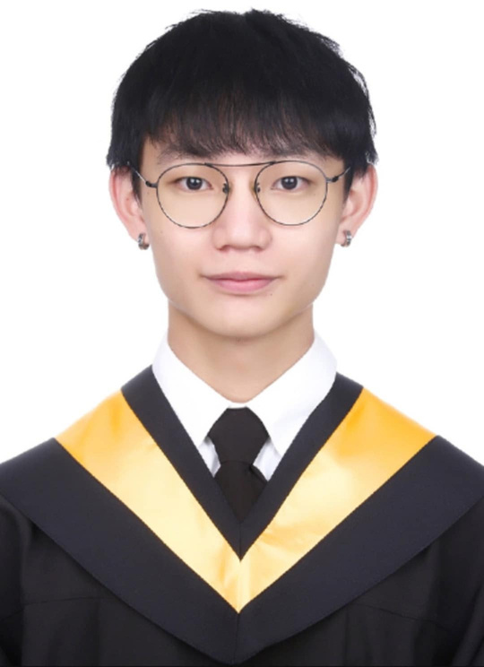
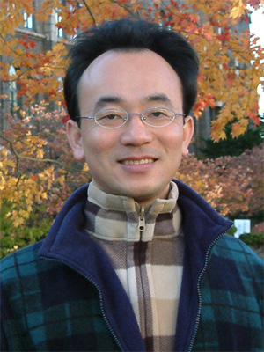

Software engineering midterm report
Real-time reconstruction of the occluded human posture of a virtual avatar in a mixed reality environment: Taking the lower body of the human body as an example
Website:https://github.com/wuboss0429/Guan-Yi-Wu.github.io
Guan-Yi Wu (Jack)
Professor: Min-Yuh Day
Institute of Information Management
Institute of Information Management
National Taipei University
Report date: 2025/04/09

Slide 2
Table of contents
Research Background
Research Motivation
Research Objectives
Expected Research Contributions and Managerial Implication

Slide 3
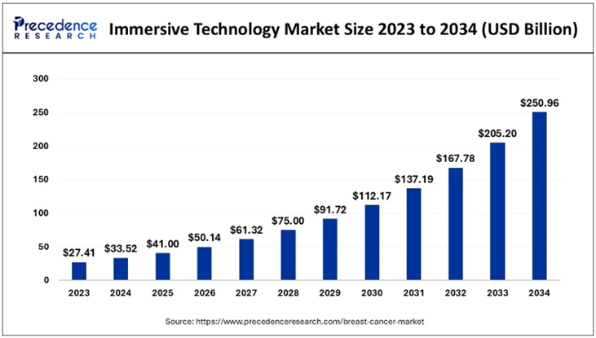
RESEARCH BACKGROUND
-Metaverse-
An important force in the transformation of digital communications and social interaction
, bringing reality into the virtual world through virtual-reality integration technology.
Immersive technology market size, 2023 to 2034 (USD Billion)。
Source：Precedence research (2024)。
1
Notes:
An important force in the transformation of digital communications and social interaction
, bringing reality into the virtual world through virtual-reality integration technology.
Precedence Research predicts that the immersive technology market will reach $250.96 billion by 2034.

Slide 4
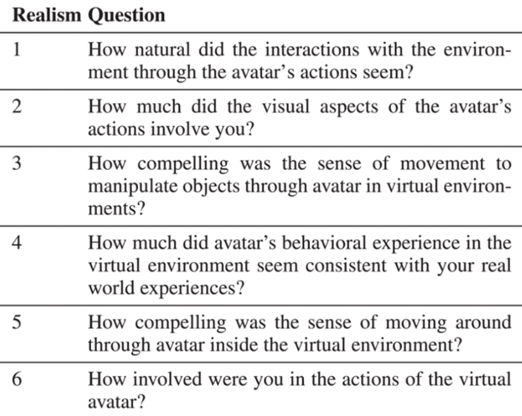
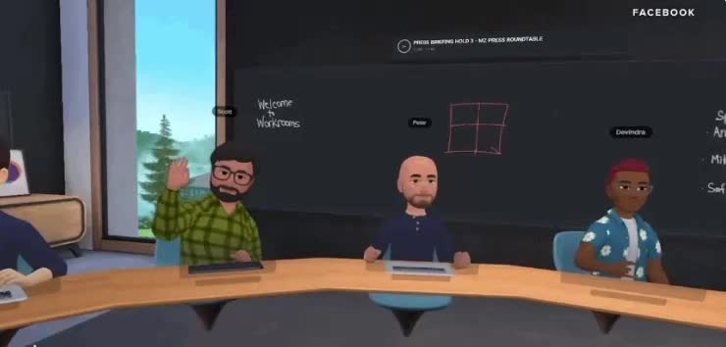
RESEARCH BACKGROUND
-Virtual Avatar-
A digital representation of the user in the virtual environment.
Realistic movements are reflected through HMD helmets and sensors.
An investigation of users' sense of reality in avatar analysis IVE.
Source: Park et al. (2025).
2
Notes:
An avatar is a digital representation of a user in a virtual environment that reflects the user's real-life movements. Through these survey questions, Park et al. found that virtual avatars are very important for users' realistic experience.

Slide 5
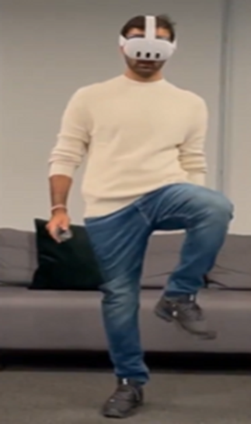
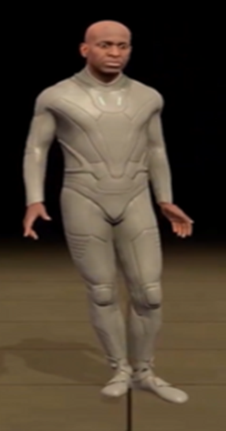
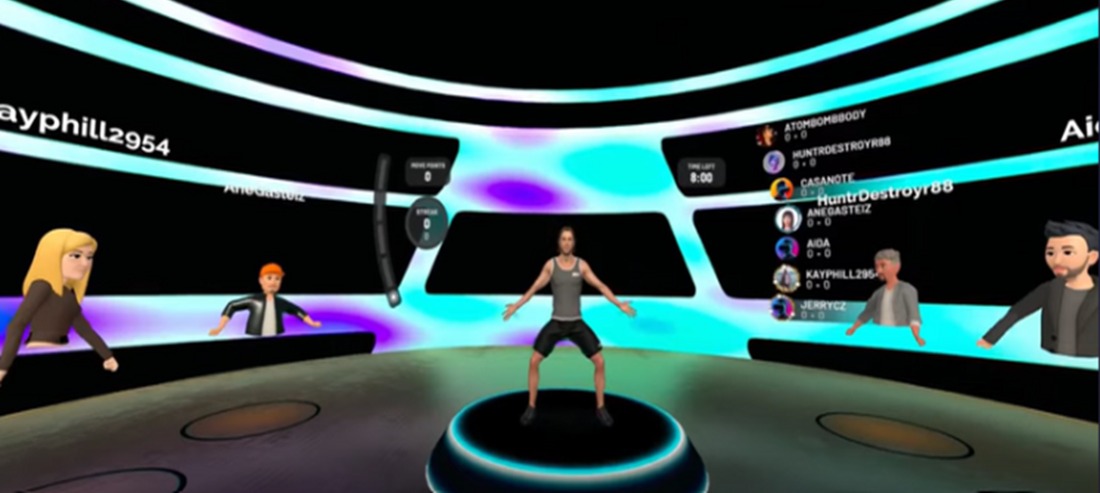

RESEARCH MOTIVATION
-Incomplete pose reconstruction-
1. Lack of complete posture
Virtual fitness training application scenarios.
Source: FitXR.
Example of incorrect posture.
Source: Quest 3 Inside-Out Upper Body Tracking.
2.posture is unnatural
3
Notes:
There are two main problems with current virtual avatars: 1. Lack of complete posture 2. Relying on AI prediction to reconstruct the lower body, but the posture is unnatural, such as lifting a foot, the virtual avatar cannot react correctly

Slide 6
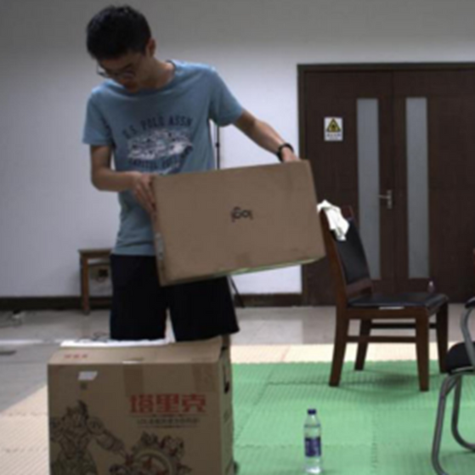
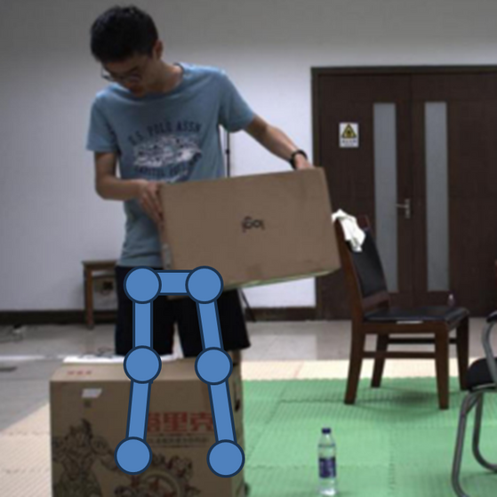
RESEARCH OBJECTIVES
-Posture reconstruction-
Propose a method to instantly and automatically reconstruct missing poses.
It makes up for the inability of virtual avatars to fully present the user's body movements and enhances the social experience in scenarios such as virtual communities or virtual meetings.
4
Notes:
propose a method to instantly and automatically reconstruct missing poses.
It makes up for the inability of virtual avatars to fully present the user's body movements and enhances the social experience in scenarios such as virtual communities or virtual meetings.

Slide 7
EXPECTED RESEARCH CONTRIBUTIONS AND MANAGERIAL IMPLICATION
Improve the integrity and naturalness of the avatar's movements, and increase the user's immersion and satisfaction.
By establishing the technical foundation for future virtual applications, software and hardware developers can gain a deeper understanding of posture reconstruction requirements and interactive experience applications.
5

Slide 8
REFERENCES
Fit XR.(2025) Retrieve from: . https://www.meta.com/zh-tw/experiences/fitxr/2327205800645550/?srsltid=AfmBOoq9MaYOoJh0ntCaVoo2o_U4VOBOwSqe2CMMuF8hwitW-Kyog5iR
iBest Network Company. (2025). https://www.ibest.com.tw/news-detail/what-is-mcp/
Park, M., Lee, J., Yang, H., & Kim, J. (2025). Designing and Analyzing Virtual Avatar Based on Rigid-Body Tracking in Immersive Virtual Environments. IEEE Access.
Quest 3 Inside-Out Upper Body Tracking. (2023). https://www.uploadvr.com/quest-3-inside-out-upper-body-tracking-and-dynamic-occlusion/
Xiao, X., Wang, J., Feng, P., Gong, A., Zhang, X., & Zhang, J. (2024). Fast Human Motion reconstruction from sparse inertial measurement units considering the human shape. Nature Communications, 15(1), 2423.
Zoting, S. Immersive Technology Market. (2024). Retrieve from:. https://www.precedenceresearch.com/immersive-technology-market
6

Slide 9
Software engineering midterm report
Real-time reconstruction of the occluded human posture of a virtual avatar in a mixed reality environment: Taking the lower body of the human body as an example
Website:https://github.com/wuboss0429/Guan-Yi-Wu.github.io
--Thanks for listening--
Guan-Yi Wu (Jack)
Professor: Min-Yuh Day
Institute of Information Management
Institute of Information Management
National Taipei University
Report date: 2025/04/09

